Slide 1
CNN Programming Recitation
Sriram

Slide 2
Due on : October 11th
Start Early. Passing the autolab part is simple enough. But the whole training process takes time to train (upto 20hrs), depending on your implementation, environment and other things.

Slide 3



What are we going to do in this homework?
Why is 6 afraid of 7?
Because 7 ate 9.
Implementing our own Convolutional Neural Net to classify numbers.

Slide 4
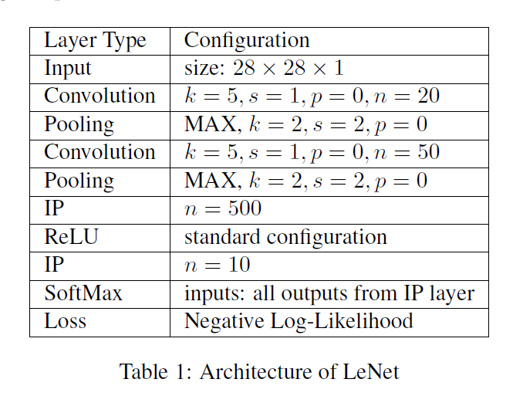
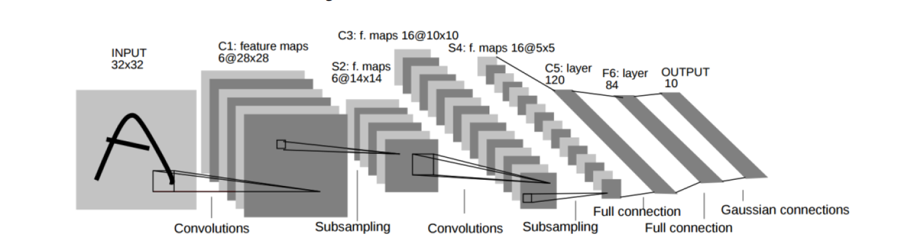
This is what you are implementing in your

Slide 5
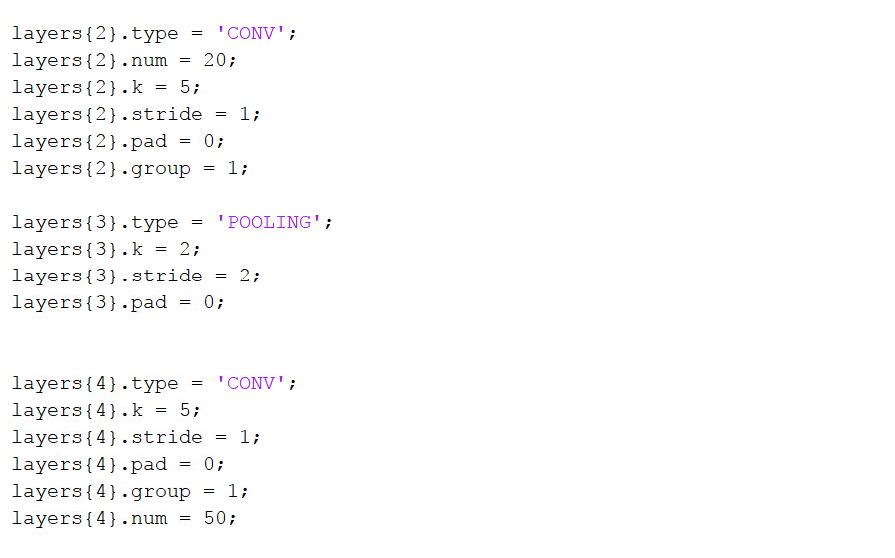

Slide 6
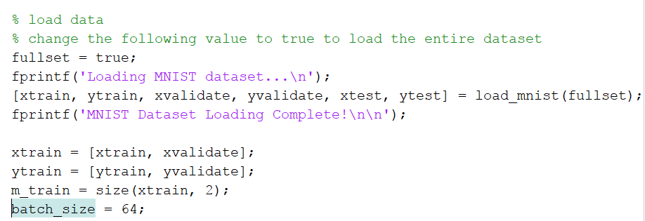
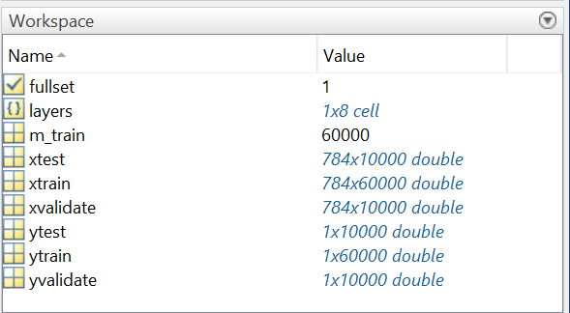
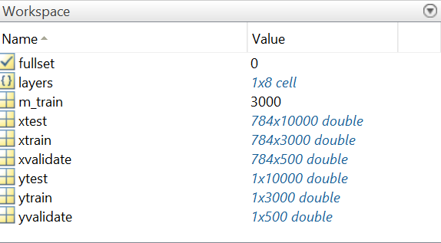
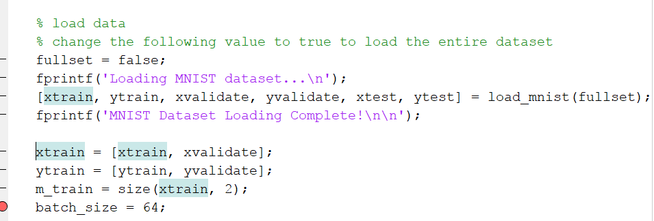
Fullset – True
All the numbers are taken from MNIST dataset and are 28x28 grayscale images.
Fullset - false
Notes:
Helpful Functions to see the numbers – reshape and imshow.

Slide 7
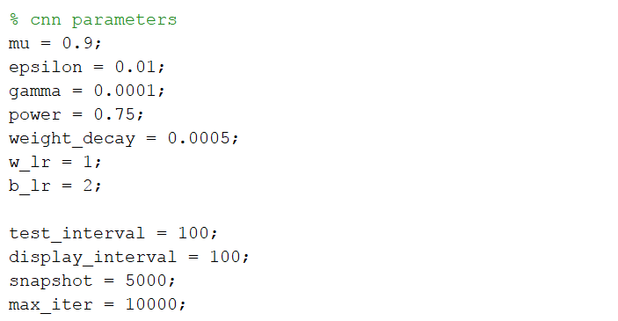
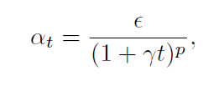
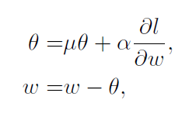
Parameters for Learning -

Slide 8
Lets look at the code

Slide 9
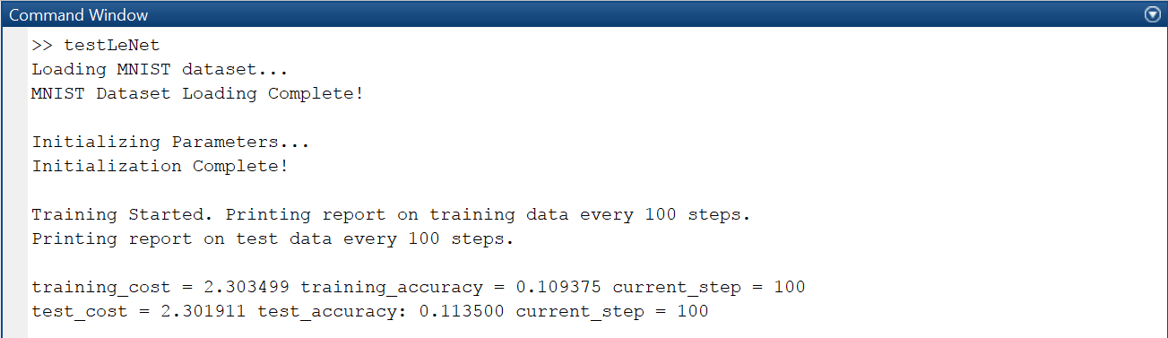
Sample output

Slide 10
Handout is one of your major resource for Information. If you have any doubts, first refer the handout.

Slide 11
A couple of things
Do not delete visualization code, we may ask for it later.
Label graphs correctly.
If Python students need help with visualization code, TAs only understand the matplotlib library.

